Slide 1
Security intelligence: solving the puzzle for actionable insight
Fran Howarth
Senior analyst, Security
Bloor Research

Slide 2
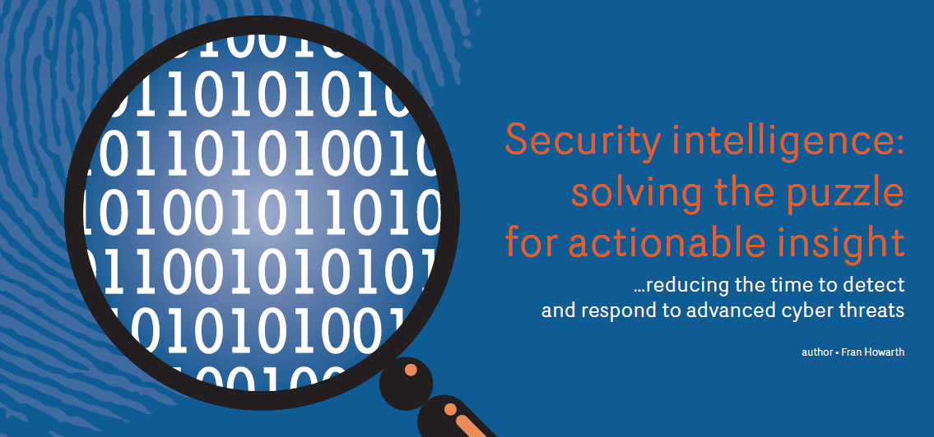

Slide 3


The situation today
“It is not if, but when and how often”
$
$
$
$
$
Targeted Sophisticated Well-resourced

Slide 4
Today’s security imperative
Prevention
Detection
Response

Slide 5
Prevention alone is not enough
Prevention
Detection
Response

Slide 6
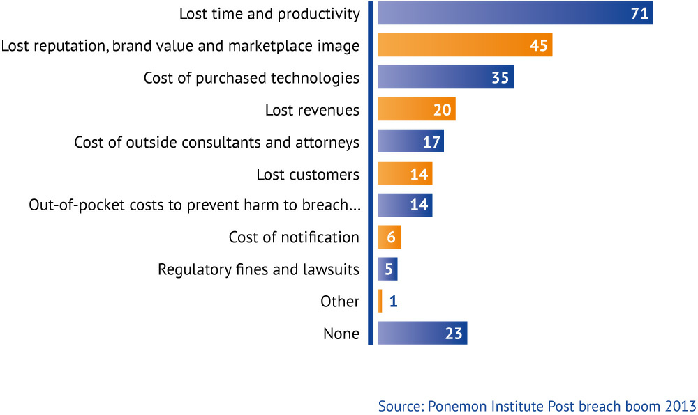
Impact of malicious breaches

Slide 7
Detection is the new imperative
Prevention
Detection
Response

Slide 8
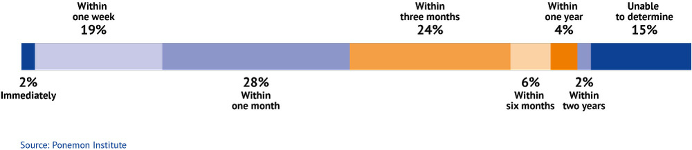
Malicious breaches take time to discover

Slide 9
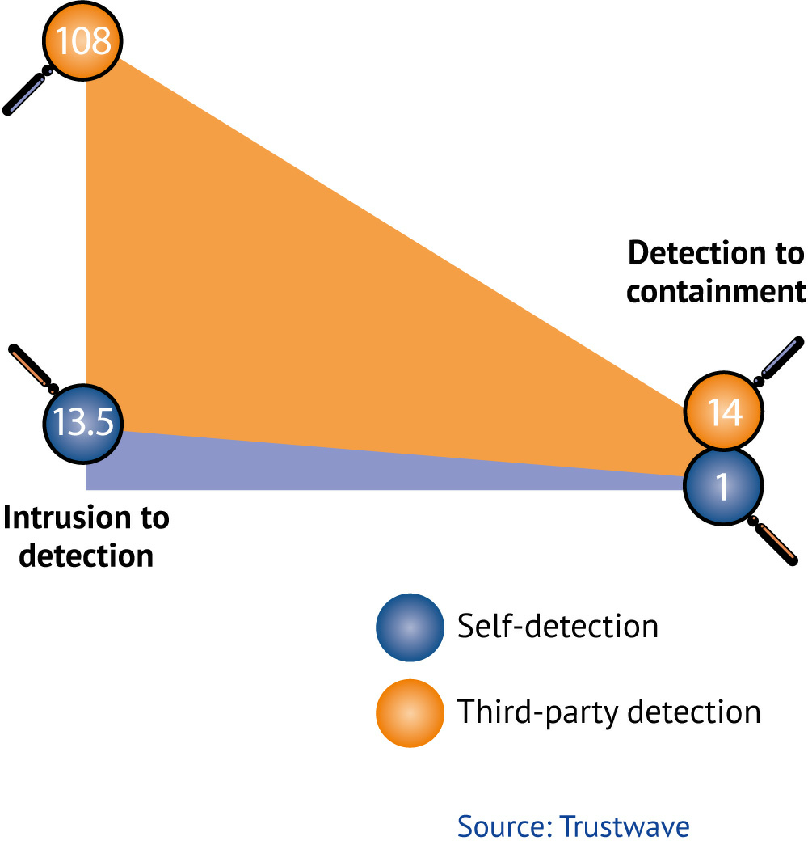
From detection to containment

Slide 10
Where remediation falls short
Prevention
Detection
Response

Slide 11
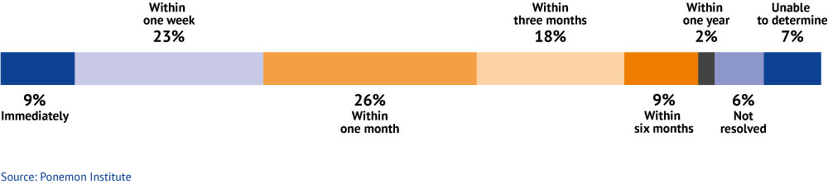
Time taken to resolve a breach

Slide 12

The role of security intelligence platforms

Slide 13
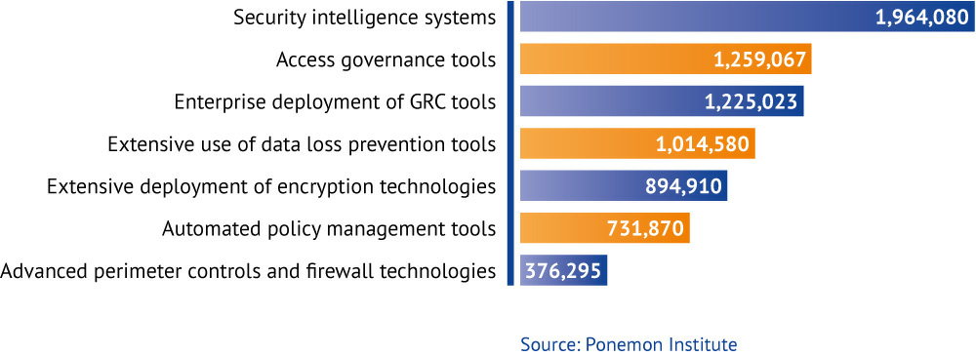
Most cost-effective security tools

Slide 14
Core capabilities
Log management and analysis
Automated remediation
Forensics
Advanced analytics
Continuous monitoring
Actionable
intelligence

Slide 15
Sample use cases
Advanced threat management
Compliance management
Continuous monitoring
Forensic investigation
Fraud detection
Insider threat detection
Monitoring of remote facilities
Network behaviour anomaly detection
Support for multiple locations
Web application defence

