Slide 1


Slide 2


Take back control: taming rogue device, user and application exposures
Mark Blake, Capita Secure Managed Services
Chris Gothard, Colt Technology Services
Fran Howarth, Bloor Research
30/04/14

Slide 3

What is Next-generation NAC?
NAC has traditionally been used to control access and reduce malware threats via user and device authentication
Growing need for real-time visibility across the network and endpoints, users and applications and need for more efficient remediation of threats/violations
NAC morphing into a platform that combines traditional NAC capabilities with mobile security, endpoint compliance and threat management
Next-gen NAC - providing actionable insight regarding endpoint health, user identities and applications, combined with security intelligence, interoperability and response
Continuously monitor and mitigate security exposures and cyber attacks
yielding more pervasive network security
Company logo

Slide 4

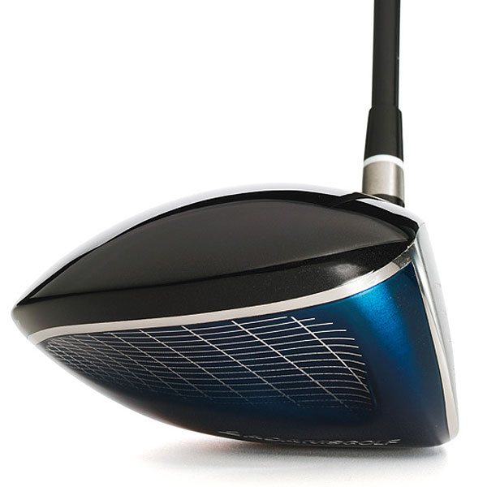
Question 1: Key Drivers
Top drivers / rationale for network visibility and endpoint control?
Company logo

Slide 5


Question 2: Considerations and Requisites
Top 2-3 technology considerations and selection criteria?
Company logo

Slide 6


Question 3: Set-up and Realisations
Ease to engage technical controls and interesting results once active?
Company logo

Slide 7

Question 4: Lessons Learned
Share some advice?
Company logo

Slide 8

Thank You & Questions
www.forescout.com
Company logo

