Slide 1
Taming the device creep
Fran Howarth, Bloor Research
fran.howarth@bloor-research.com

Slide 2
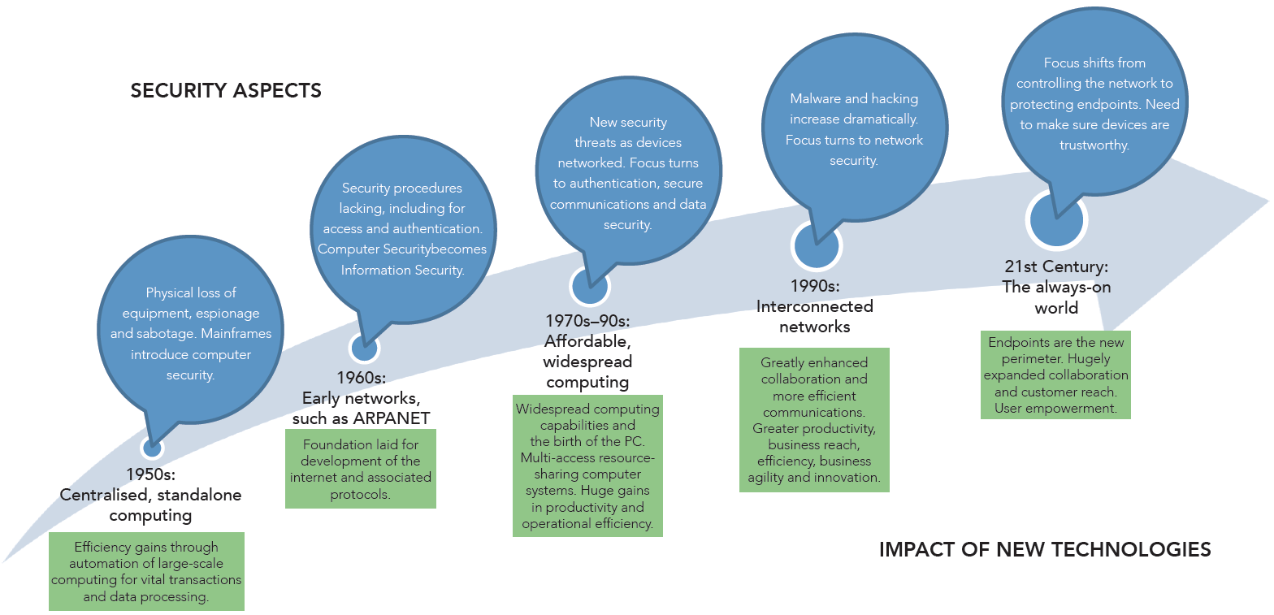
Why are devices so important? How we got here....

Slide 3
What the future holds

Slide 4
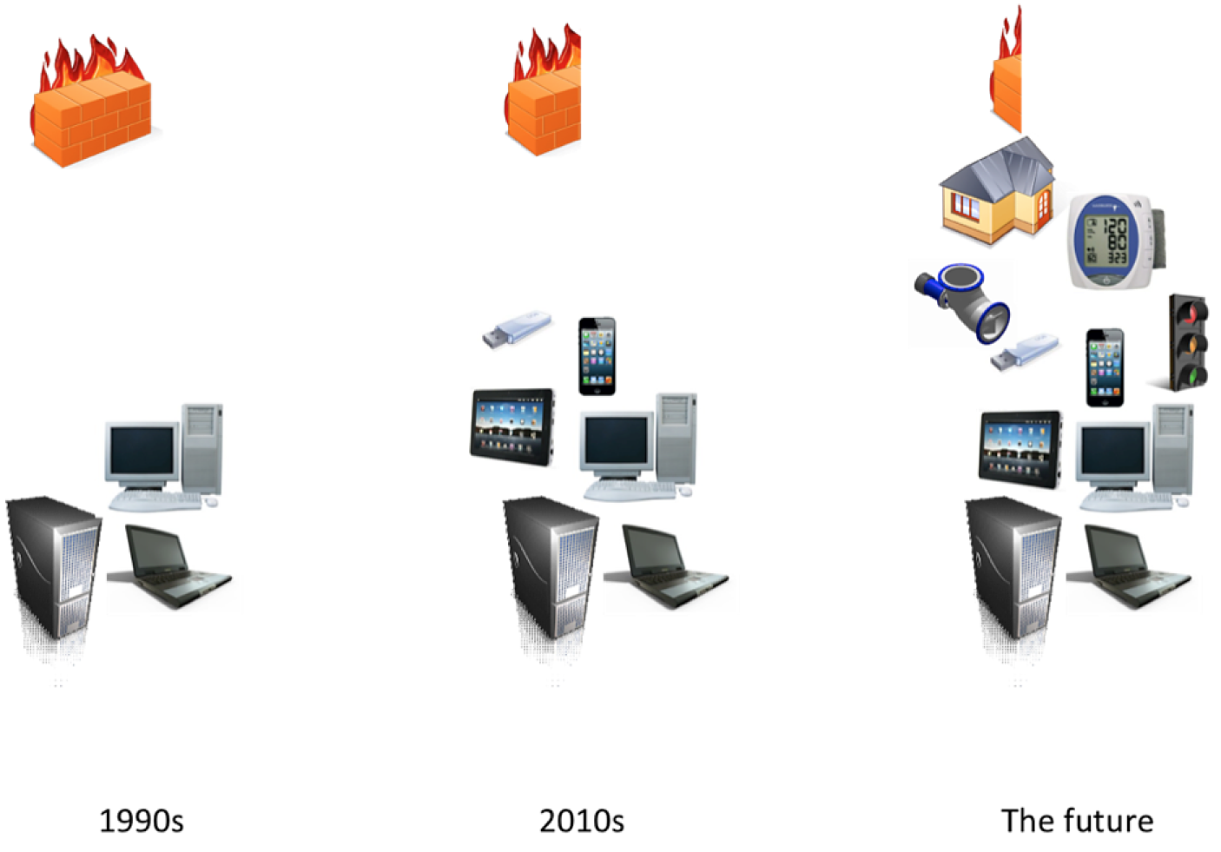
Where we are today

Slide 5
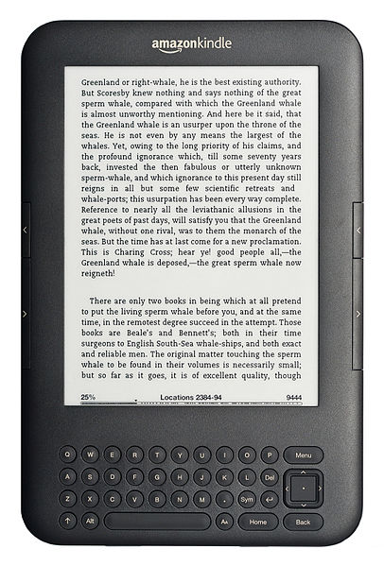
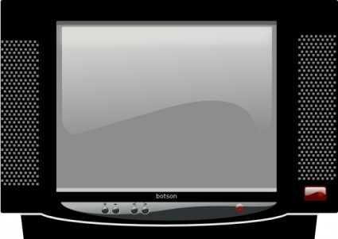
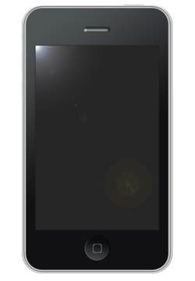
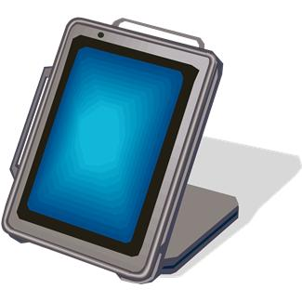
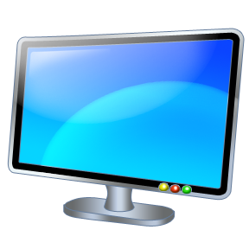
Device proliferation
Sources: IMS Research, Cisco

Slide 6
Personal vs corporate devices
Overall, 62% use their personal devices for work,
but only 28% claim that their IT department is aware
Source: Workshare

Slide 7
Need for access on the move
81% employees access work documents on the move,
69% use free file sharing platforms overall
Source: Workshare

Slide 8
“Bring your own app”
Source: Portio Research

Slide 9
Emerging technologies useful for work?
How long will this take to happen?
16% say immediately, 33% say when costs come down.
Just 8% say such technologies will not
become widespread.
Source: Fortinet

Slide 10
Where does this leave us?
In a security mess—sensitive data resides on a mass of devices, many of which lack appropriate security controls.
Blindsided—unable to see all the devices, endpoints, users and applications and resources on the network they are connected to.
Struggling to keep up—productivity declines if access cannot be granted and controlled effectively.

Slide 11
What is needed?
VISIBILITY over:
Who the users are—their profile, their role
What devices they are using—and where they are and what apps they are using for context-based access decisions
What network systems are affected
The information security risk in terms of overall operational risk
Policy enforcement

Slide 12
Putting it all together

