Slide 1
Replication for real-time warehousing
Philip Howard
Research Director – Bloor Research

Slide 2
Agenda
What is data replication?
When would you use it?
What are its requirements?

Slide 3
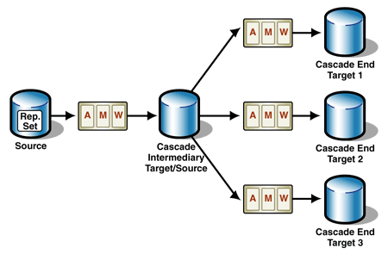
What is data replication?
“The process of copying a portion of a database from one environment to another and keeping the subsequent copies of the data in sync with the original source. Changes made to the original source are propagated to the copies of the data in other environments.”

Slide 4
When would you use data replication?
Data warehousing and BI
Loading real-time data for operational BI
Supporting real-time query/reporting
Integrating CEP with operational data
Operational synchronisation
E.g. Lookers v Bookers
E.g. synchronising (POS and) central pricing data
High/continuous availability
Data migration (zero downtime)
Master data management
To update/broadcast from a hub
High/continuous availability
…

Slide 5
Enabling data replication
Performance
Native interfaces
Support for parallelism
Compression
Change data capture
Impact minimalism
Heterogeneity
Topology support
Synchronisation
Graphical development and management/monitoring
In operational/HA environments: transactional integrity

Slide 6
Performance 1: native interfaces
High level interfaces (O/JDBC) not fast enough

Slide 7
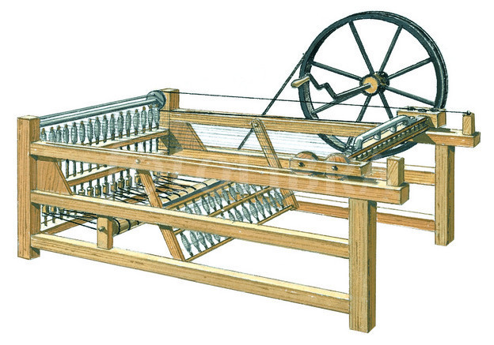
Performance 2: parallelism

Slide 8
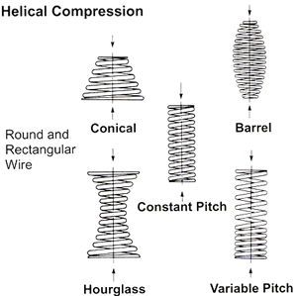
Performance 3: compression
One size does not fit all

Slide 9
Performance 4: CDC

Slide 10
Performance 5: impact minimalism

Slide 11
Heterogeneity

Slide 12
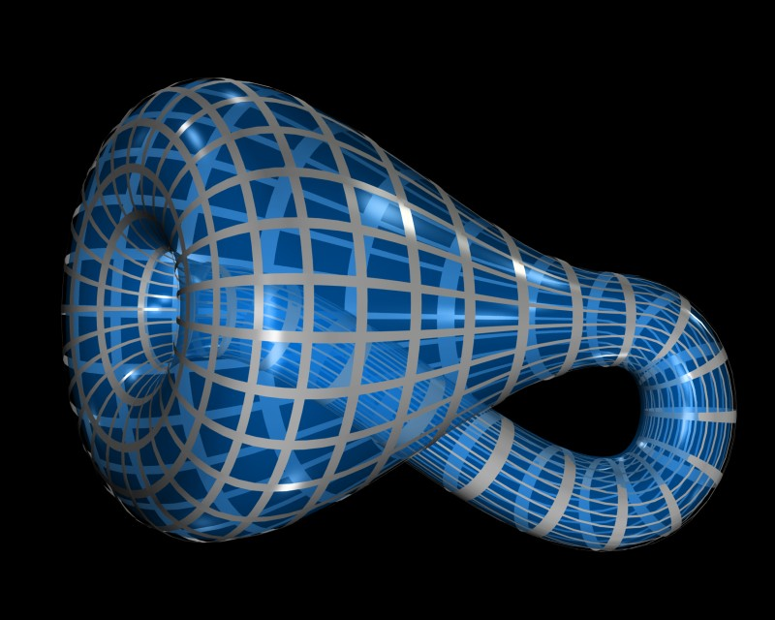
Topology support
1 to 1
1 to Many
Many to 1 M to M
1 to 1 to 1
etc

Slide 13
Synchronisation

Slide 14
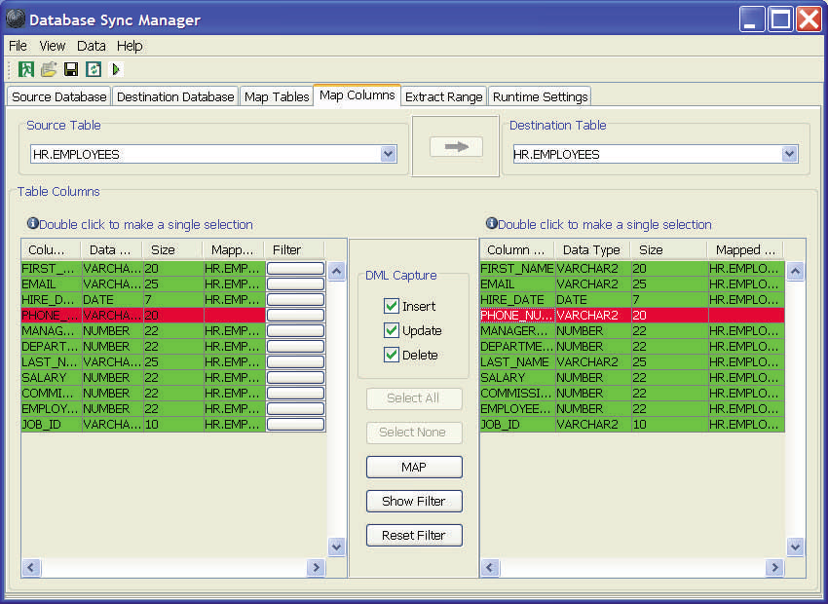
Development & Monitoring

Slide 15
Conclusion
Replication serves sundry purposes
Fastest growing adoption for BI
Key requirement is performance but multiple others
Complementary (not competitive) to both data integration and data virtualisation

